Slide 1
Predicting College Football Outcomes Using Machine Learning Methods
Kevin Wang
The Ohio State University

Slide 2
Background and Objective:
College football outcome predictions have grown increasingly sophisticated
Existing models such as ESPN's FPI+ and Massey Ratings are inconsistent
Develop ML model using individual and pairwise differences in team-level metrics
Use of rolling windows (1-5 games) to capture momentum and recent team form
Evaluate performance using accuracy scores, ROC-AUC

Slide 3
Data
Highlights:
6 seasons
10,000+ games
~700 teams
40+ team-level performance metrics

Slide 4
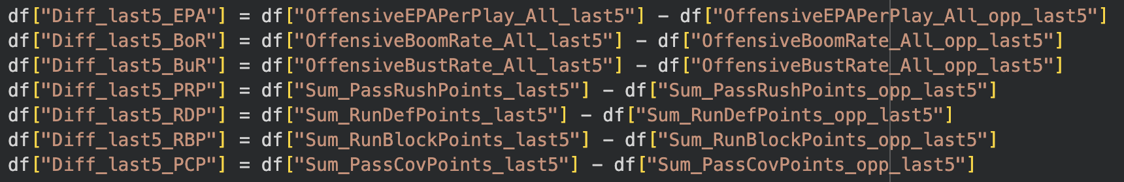
Variables
Pairwise Differences
Comparing differences of the same metric for team and opponent
Individual Team Metrics
Uses raw performance data for the team only

Slide 5
Methods
Support Vector Machine (SVM)
ML method for classification and regression
Multi-layer Perceptron (MLP)
Neural network model for classification and regression
Hidden Layer Size: (64, 32)
Rolling windows (1-5 games)

Slide 6
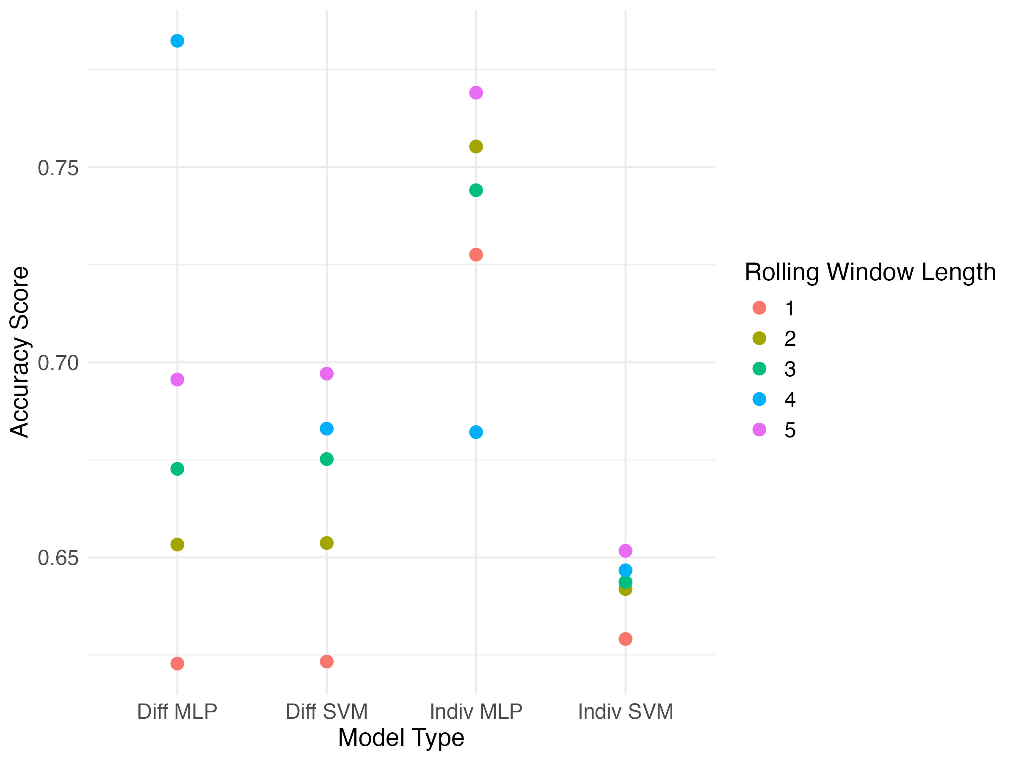
Accuracy Score by Rolling Window Length
Pairwise differences MLP with 2-game rolling window performs best
MLP with individual team-level metrics has highest average over all rolling window lengths

Slide 7
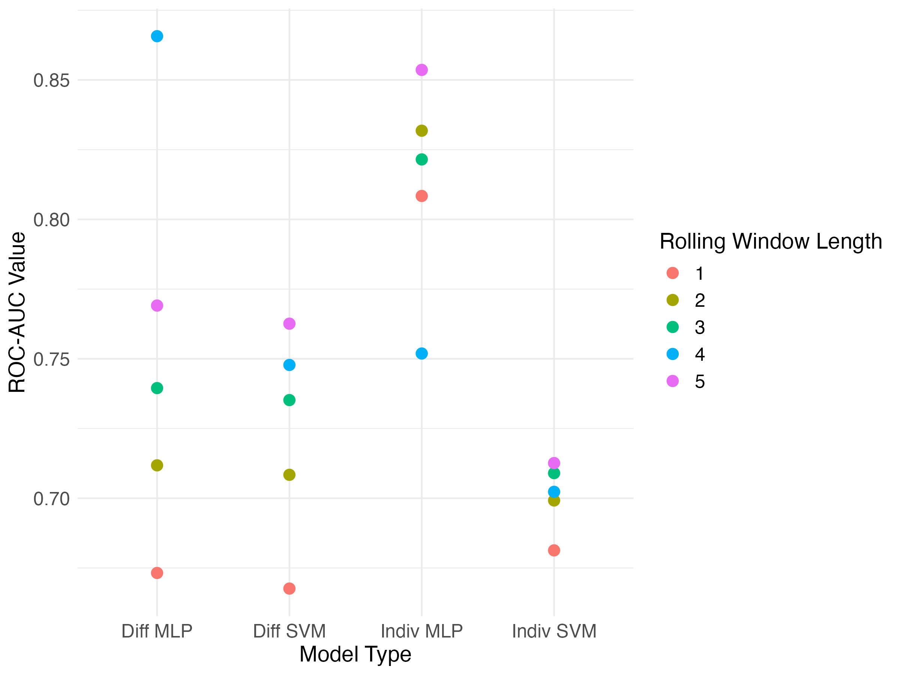
ROC-AUC by Rolling Window Length
Pairwise differences MLP with 2-game rolling window has highest ROC-AUC
MLP with individual team-level metrics showed greatest consistency across all rolling window lengths
Conclusion: individual team-level metrics paired with MLP yields better, more stable predictive performance

Slide 8
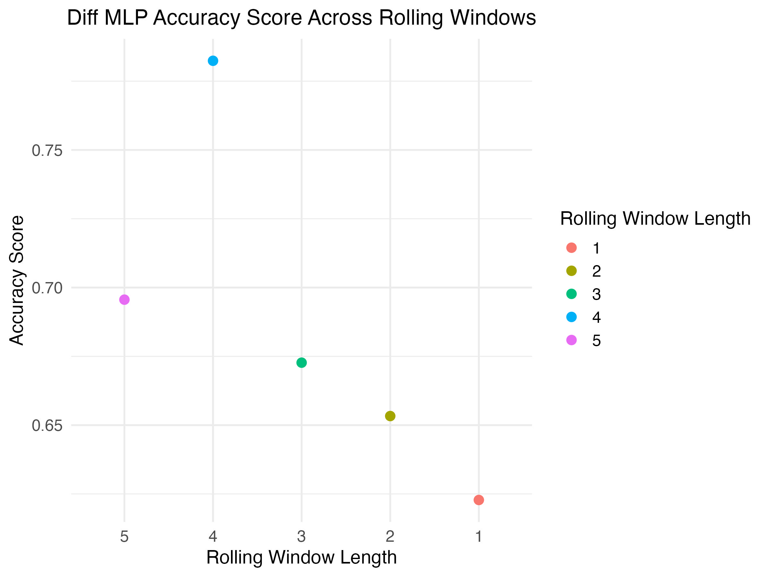
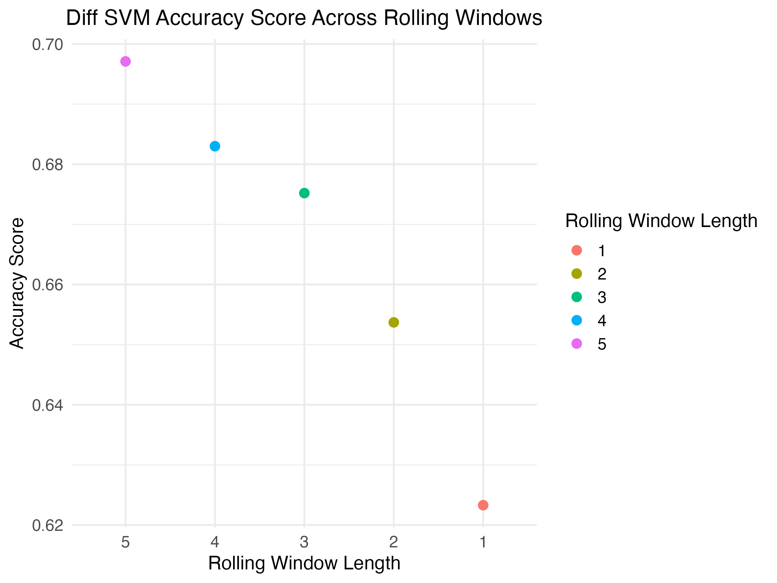
Model Comparison

Slide 9
Conclusions
Best Performer: MLP on individual team metrics
Limitations:
Injuries, weather, momentum (win streaks)
Length of season (only 12 games)
Future Work:
Include additional metrics (i.e. recruiting rankings, coaching, playstyle)

Slide 10
Acknowledgements
Dr. Lang Li, PhD, Professor and Chair, Department of Biomedical Informatics
Chen Yang, The Ohio State University
The Ohio State Hackathon Data provided by Sports Info Solutions

